Slide 1
Unit 6

Slide 2
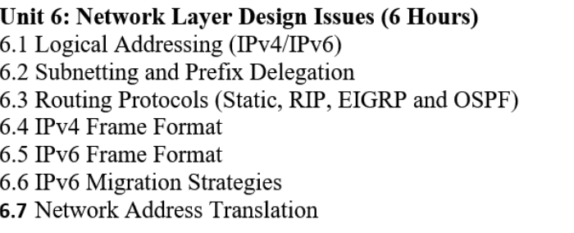

Slide 3
(IPv4).
IP stands for Internet Protocol and v4 stands for Version Four (IPv4).
IPv4 was the primary version brought into action for production within the ARPANET in 1983.
IP version four addresses are 32-bit integers which will be expressed in decimal notation.
Example- 192.0.2.126 could be an IPv4 address.

Slide 4
Characteristics of IPv4
IPv4 could be a 32-Bit IP Address.
IPv4 could be a numeric address, and its bits are separated by a dot.
The number of header fields is twelve and the length of the header field is twenty.
It has Unicast, broadcast, and multicast style of addresses.
IPv4 supports VLSM (Virtual Length Subnet Mask).
IPv4 uses the Post Address Resolution Protocol to map to the MAC address.
RIP may be a routing protocol supported by the routed daemon.
Networks ought to be designed either manually or with DHCP.
Packet fragmentation permits from routers and causing host.

Slide 5
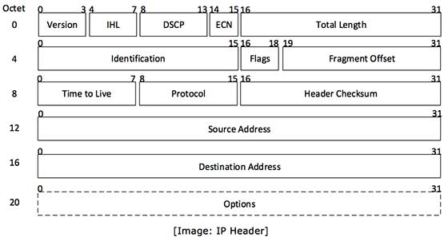

Slide 6
IP header includes many relevant information including Version Number, which, in this context, is 4. Other details are as follows −
Version − Version no. of Internet Protocol used (e.g. IPv4).
IHL − Internet Header Length; Length of entire IP header.
DSCP − Differentiated Services Code Point; this is Type of Service.
ECN − Explicit Congestion Notification; It carries information about the congestion seen in the route.
Total Length − Length of entire IP Packet (including IP header and IP Payload).
Identification − If IP packet is fragmented during the transmission, all the fragments contain same identification number. to identify original IP packet they belong to.
Flags − As required by the network resources, if IP Packet is too large to handle, these ‘flags’ tells if they can be fragmented or not. In this 3-bit flag, the MSB is always set to ‘0’.
Fragment Offset − This offset tells the exact position of the fragment in the original IP Packet.
Time to Live − To avoid looping in the network, every packet is sent with some TTL value set, which tells the network how many routers (hops) this packet can cross. At each hop, its value is decremented by one and when the value reaches zero, the packet is discarded.
Protocol − Tells the Network layer at the destination host, to which Protocol this packet belongs to, i.e. the next level Protocol. For example protocol number of ICMP is 1, TCP is 6 and UDP is 17.
Header Checksum − This field is used to keep checksum value of entire header which is then used to check if the packet is received error-free.
Source Address − 32-bit address of the Sender (or source) of the packet.
Destination Address − 32-bit address of the Receiver (or destination) of the packet.
Options − This is optional field, which is used if the value of IHL is greater than 5. These options may contain values for options such as Security, Record Route, Time Stamp, etc.

Slide 7
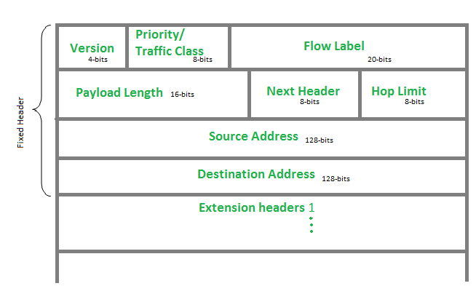
IP version 6
IP version 6 is the new version of Internet Protocol, which is way better than IP version 4 in terms of complexity and efficiency.
The header of IP version 6 and understand how it is different from the IPv4 header.

Slide 8
Version (4-bits): Indicates version of Internet Protocol which contains bit sequence 0110.
Traffic Class (8-bits): The Traffic Class field indicates priority of IPv6 packet which is similar to Service Field in IPv4 packet.
It helps routers to handle the traffic based on the priority of the packet. If congestion occurs on the router then packets with the least priority will be discarded.
As of now, only 4-bits are being used (and the remaining bits are under research), in which 0 to 7 are assigned to Congestion controlled traffic and 8 to 15 are assigned to Uncontrolled traffic.

Slide 9
Flow Label (20-bits):
Flow Label field is used by a source to label the packets belonging to the same flow in order to request special handling by intermediate IPv6 routers, such as non-default quality of service or real-time service.
In order to distinguish the flow, an intermediate router can use the source address, a destination address, and flow label of the packets.
Between a source and destination, multiple flows may exist because many processes might be running at the same time.
Routers or Host that does not support the functionality of flow label field and for default router handling, flow label field is set to 0.
While setting up the flow label, the source is also supposed to specify the lifetime of the flow.

Slide 10
Payload Length (16-bits):
It is a 16-bit (unsigned integer) field, indicates the total size of the payload which tells routers about the amount of information a particular packet contains in its payload.
The payload Length field includes extension headers(if any) and an upper-layer packet.
In case the length of the payload is greater than 65,535 bytes (payload up to 65,535 bytes can be indicated with 16-bits), then the payload length field will be set to 0 and the jumbo payload option is used in the Hop-by-Hop options extension header.
Next Header (8-bits):
Next Header indicates the type of extension header(if present) immediately following the IPv6 header.
Whereas In some cases it indicates the protocols contained within upper-layer packets, such as TCP, UDP.

Slide 11
Hop Limit (8-bits):
Hop Limit field is the same as TTL in IPv4 packets.
It indicates the maximum number of intermediate nodes IPv6 packet is allowed to travel.
Its value gets decremented by one, by each node that forwards the packet and the packet is discarded if the value decrements to 0.
This is used to discard the packets that are stuck in an infinite loop because of some routing error.
Source Address (128-bits): Source Address is the 128-bit IPv6 address of the original source of the packet.

Slide 12
Destination Address (128-bits):
The destination Address field indicates the IPv6 address of the final destination(in most cases).
All the intermediate nodes can use this information in order to correctly route the packet.
Extension Headers:
In order to rectify the limitations of the IPv4 Option Field, Extension Headers are introduced in IP version 6.
The extension header mechanism is a very important part of the IPv6 architecture.
The next Header field of IPv6 fixed header points to the first Extension Header and this first extension header points to the second extension header and so on

Slide 13
The different types of addresses defined by IPv6
In IPv6, three types of network addresses are defined.
They are :
Unicast address
Multicast address
Anycast address

Slide 14
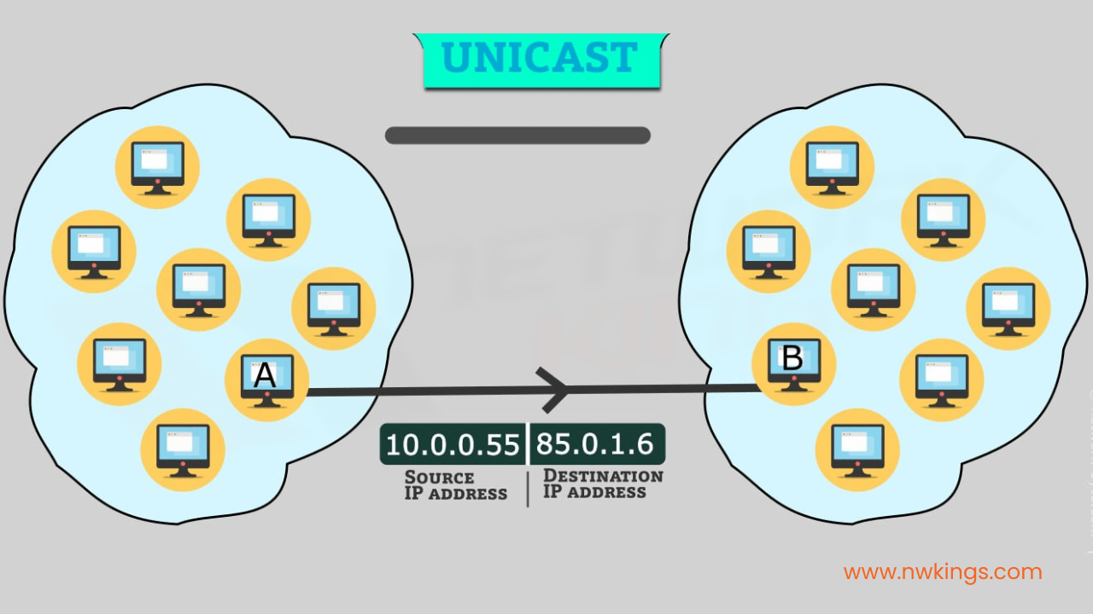
Unicast
When a computer that is the source wants to communicate with another computer which is the destination, it uses the unicast address as a destination.
Therefore, the unicast address refers to a single/individual host.
The unicast is used to send data to a single destination.
It communicates one to one.

Slide 15
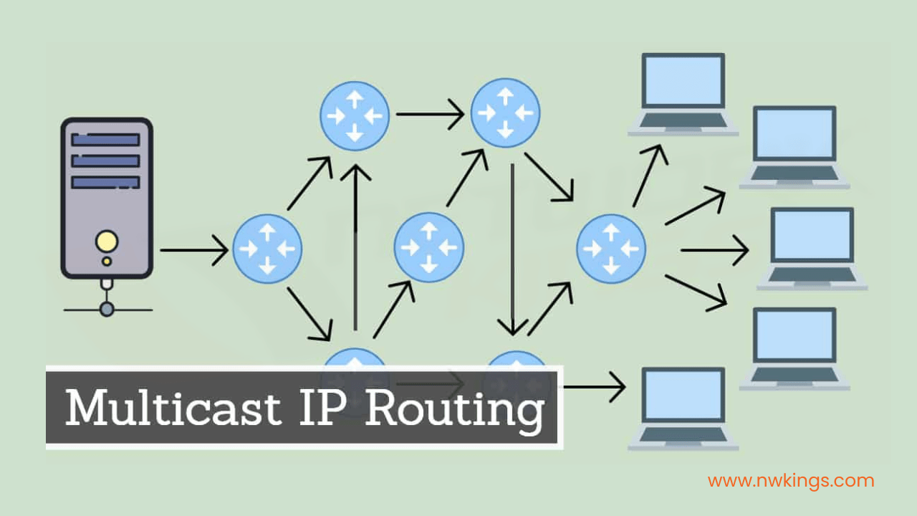
Multicast
A multicast address is used to deliver a package to a group of destinations.
Therefore, a single source is able to communicate with many other destination hosts.
The packet sent by the multicast address is delivered to every host that is a part of that specific group.
The multicast has a one-to-many relationship.
The range for the multicast address is FF00::/8.
There is no need to make a different range for broadcasting a message.
The multicast can broadcast the message.
The broadcasting is done by using special multicast groups – all IPv6 devices and a solicited-node multicast address.

Slide 16
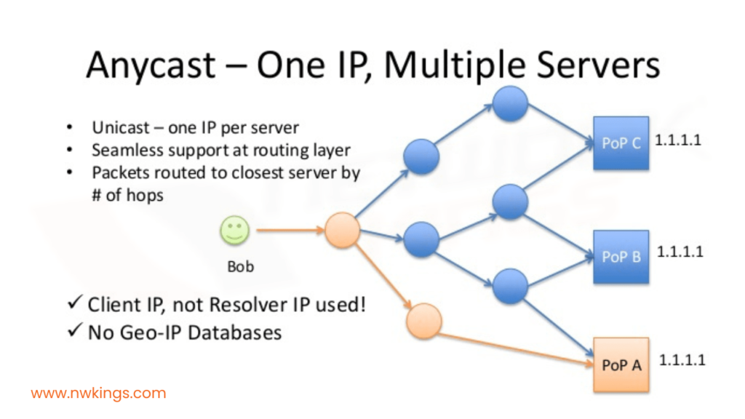
3. Anycast
The anycast address is identical to the multicast address.
The anycast address is different from other addresses in a way that it sends the same IP address to different devices/servers.
Note that the IP address is not sent to the hosts.
In other words, an anycast address is assigned to more than one interface or a group of interfaces.
Anycast address is mostly used in websites such as Google, where it hits the nearest server based on a location.
For example, if you live in India, the router sends your request to the Indian servers of Google.
Therefore, assigning a unicast address to more than one interface makes a unicast address an anycast address.
Anycast address delivers packets to its nearest interface.

Slide 17
IPv6 migration strategies
IPv6 migration strategies primarily use Dual-Stack, running IPv4 and IPv6 side-by-side.
Tunneling, encapsulating IPv6 over IPv4 networks.
Translation (like NAT64) allows IPv6-only devices to talk to IPv4 services, while a full transition involves assessment, phased rollout (often starting with external services), thorough testing, and ongoing management for seamless interoperability as networks evolve

Slide 18
Migration Mechanisms
Dual-Stack
Tunneling
Translation (NAT64/DNS64)

Slide 19
What is IPv6 Transition?
IPv6 transition mechanisms are techniques used to allow IPv4 and IPv6 networks to coexist while the internet gradually moves from IPv4 to IPv6.
Dual Stack is the most important and commonly used transition mechanism.

Slide 20
Dual Stack means running IPv4 and IPv6 at the same time on the same device and network.
A device (PC, server, router, mobile, etc.) is configured with:
One IPv4 address
One IPv6 address
So the device can communicate using either protocol, depending on what the destination supports.
Dual-Stack refers to a networking approach where devices, routers, and applications support both IPv4 and IPv6 protocols simultaneously,
Allowing seamless communication across both older and newer addressing systems during the transition to IPv6, with devices typically preferring IPv6 but falling back to IPv4 if needed.
This enables gradual IPv6 adoption without disrupting existing IPv4 services, as devices maintain separate IPv4 and IPv6 configurations and can handle connections using either protocol independently

Slide 21
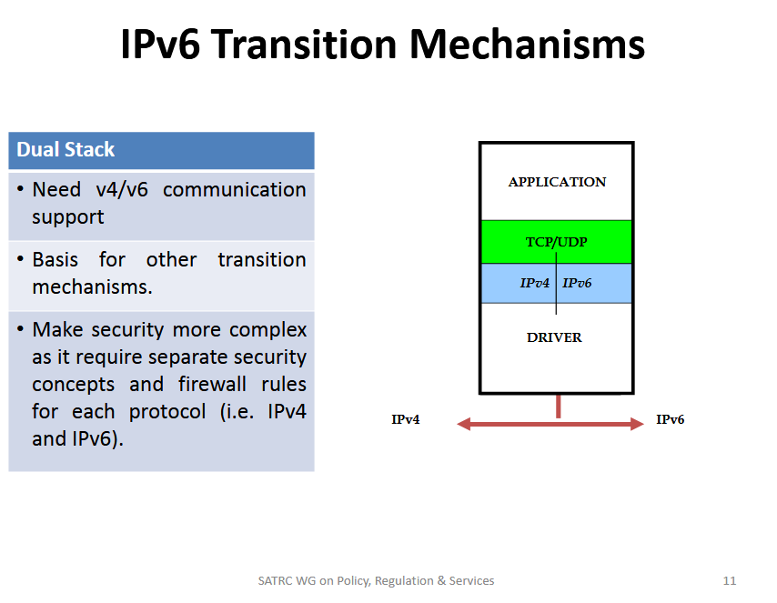
1. Application Layer
Applications (web browser, email, FTP, etc.) do not care whether IPv4 or IPv6 is used.
They just request a connection.
2. Transport Layer (TCP/UDP)
TCP and UDP work the same way for both IPv4 and IPv6.
No major change is required here.
3. Network Layer (IPv4 and IPv6)
Both IPv4 and IPv6 stacks exist side-by-side
The operating system decides:
Use IPv6 if the destination supports IPv6
Otherwise, fall back to IPv4
4. Driver / Network Interface
The same network hardware (NIC) supports both IPv4 and IPv6 traffic.
Arrow (IPv4 ↔ IPv6)
Shows that the system can send and receive both IPv4 and IPv6 packets.

Slide 22
How Dual Stack Works (Step-by-Step Example)
Example:
You open a website: www.example.com
Your computer asks DNS for the address.
DNS replies with:
AAAA record (IPv6) → if available
A record (IPv4) → if available
Your system prefers IPv6.
If IPv6 fails or is unavailable:
It automatically uses IPv4
➡️ This process is automatic and seamless.
Need v4/v6 Communication Support”
During transition, many servers are still IPv4-only.
Some are IPv6-only.
Dual Stack allows communication with both types of networks.

Slide 23
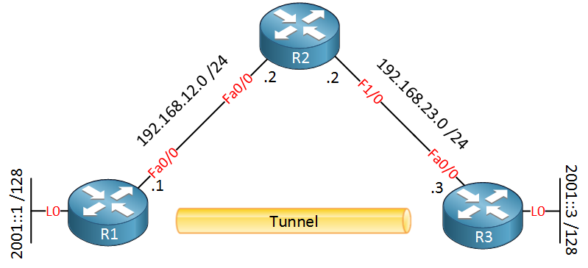
Tunneling
Tunneling enables isolated IPv6 networks to communicate across an existing IPv4 infrastructure by encapsulating IPv6 packets inside IPv4 packets.
This transition mechanism allows for connectivity without immediate, full-scale upgrading of intermediate routers, bridging gaps in IPv6 support

Slide 24
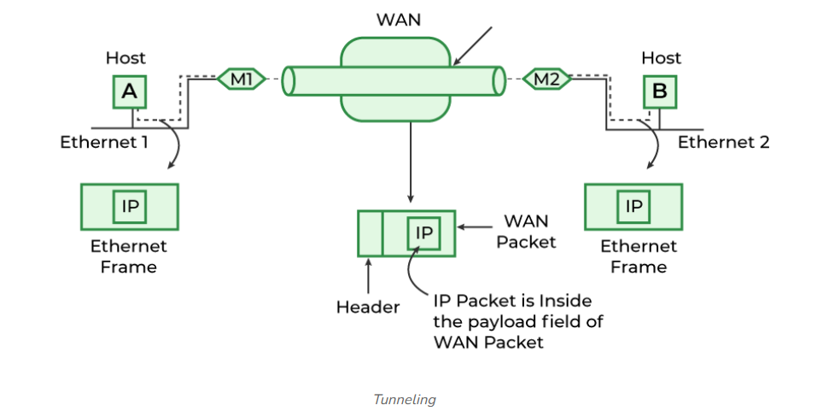
A technique of inter-networking called Tunneling is used when source and destination networks of the same type are to be connected through a network of different types.
Tunneling uses a layered protocol model such as those of the OSI or TCP/IP protocol suite.
So, in other words, when data moves from host A to B it covers all the different levels of the specified protocol (OSI, TCP/IP, etc.) while moving between different levels, data conversion (Encapsulation) to suit different interfaces of the particular layer is called tunneling.

Slide 25
The task is sent on an IP packet from host A of Ethernet-1 to host B of Ethernet-2 via a WAN.
Steps
Host A constructs a packet that contains the IP address of Host B.
It then inserts this IP packet into an Ethernet frame and this frame is addressed to the multiprotocol router M1
Host A then puts this frame on Ethernet.
When M1 receives this frame, it removes the IP packet, inserts it in the payload packet of the WAN network layer packet, and addresses the WAN packet to M2.
The multiprotocol router M2 removes the IP packet and sends it to host B in an Ethernet frame.

Slide 26
How Does Encapsulation Work?
Data travels from one place to another in the form of packets, and a packet has two parts, the first one is the header which consists of the destination address and the working protocol and the second thing is its contents.
In simple terminology, Encapsulation is the process of adding a new packet within the existing packet or a packet inside a packet.
In an encapsulated packet, the header part of the first packet is remain surrounded by the payload section of the surrounding packet, which has actual contents.

Slide 27
Translation (NAT64/DNS64):
NAT64 and DNS64 are complementary technologies used together to allow IPv6-only clients to communicate with IPv4-only servers, facilitating the transition from IPv4 to IPv6 without requiring a dual-stack network

Slide 28
NAT64 (Network Address Translation 64):
A stateful mechanism that translates IPv6 packets into IPv4 packets and vice versa.
It operates at the edge of the network, using a pool of IPv4 addresses and port address translation (PAT) to map multiple IPv6 clients to one or more IPv4 addresses.
DNS64 (DNS extensions for NAT64): A DNS mechanism that synthesizes AAAA records (IPv6) from A records (IPv4). When an IPv6-only client requests the address of an IPv4-only server, the DNS64 server creates a synthetic IPv6 address (using a special prefix, commonly 64:ff9b::/96) that embeds the actual IPv4 address

Slide 29
How the Translation Works (Flow)
Request: An IPv6-only client tries to connect to an IPv4-only server (e.g., example.com).
DNS64 Synthesis: The client asks for the AAAA record. The DNS64 server receives no AAAA record, so it asks for the A record.
IT takes the IPv4 address, embeds it into the 64:ff9b::/96 prefix, and returns this synthetic IPv6 address to the client.
Routing: The client sends IPv6 packets to this synthetic address. Network routing directs these packets to the NAT64 device.
NAT64 Translation: The NAT64 device removes the prefix to reveal the destination IPv4 address
It translates the source IPv6 address to an IPv4 address (using its own pool) and translates the packet headers.
Return Traffic: When the IPv4 server replies, the NAT64 device uses its state table to map the IPv4 address back to the original IPv6 client address.

Slide 30
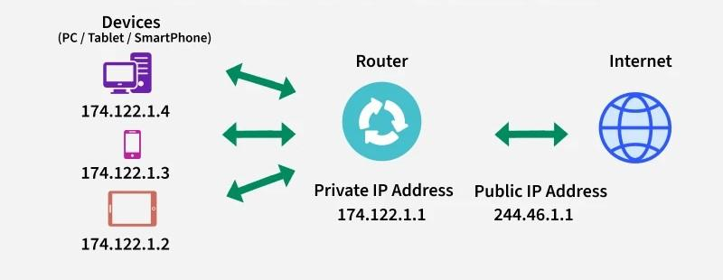
Network Address Translation (NAT)
Network Address Translation (NAT) allows multiple devices in a private network to access the internet using a single public IP address.
It helps conserve IPv4 addresses and hides internal systems for added security.
Translates private IPs to public IPs and vice versa.
Prevents IPv4 address exhaustion
Adds security by masking internal devices
Allows thousands of devices to share one public IP

Slide 31
Note: IPv4 provides only 2³² (about 4.3 billion) addresses, which is insufficient considering the massive number of devices connected to the Internet. NAT prevents IP exhaustion by enabling thousands of private devices to share a limited number of public IP addresses.

Slide 32
Working of NAT
This explains how NAT functions:
A device sends a request → reaches the NAT-enabled router.
Router replaces the private IP with its public IP and assigns a unique port.
NAT stores this mapping in the NAT table.
When the server responds, NAT uses the stored entry to send the packet to the correct internal device.
Why this works:
Many devices can share one public IP
Port numbers separate device traffic
Internal IPs stay hidden from the internet

Slide 33
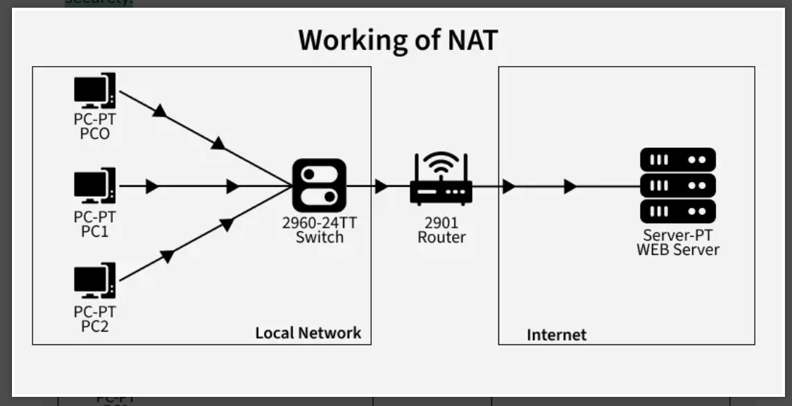
Examples of NAT Usage
Connecting Private Networks to the Internet:
A NAT - enabled router translates all private IPs to a single public IP, allowing internal devices to access the Internet securely.
Linking Multiple Office Locations: Organizations use NAT to translate IPs between branches, enabling communication across locations while maintaining private IP schemes internally.

Slide 34
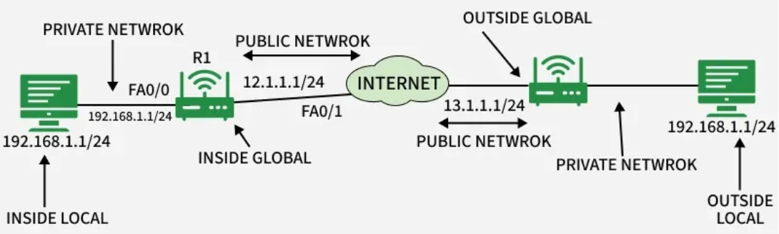
Why NAT Masks Port Numbers?
If two internal devices use the same port to reach the same destination, replies become indistinguishable. NAT fixes this by:
Changing both the private IP and source port
Storing a unique entry in the NAT table
Ensuring replies reach the correct device
NAT Inside and Outside Addresses
Inside refers to the addresses which must be translated.
Outside refers to the addresses which are not in control of an organization.
These are the network addresses where the translation will occur.

Slide 35
Term | Meaning
Inside Local | Private IP inside the network (actual host IP).
Inside Global | Public IP representing the inside host externally.
Outside Local | Destination IP as seen inside the local network.
Outside Global | Actual IP of the external destination host.

Slide 36
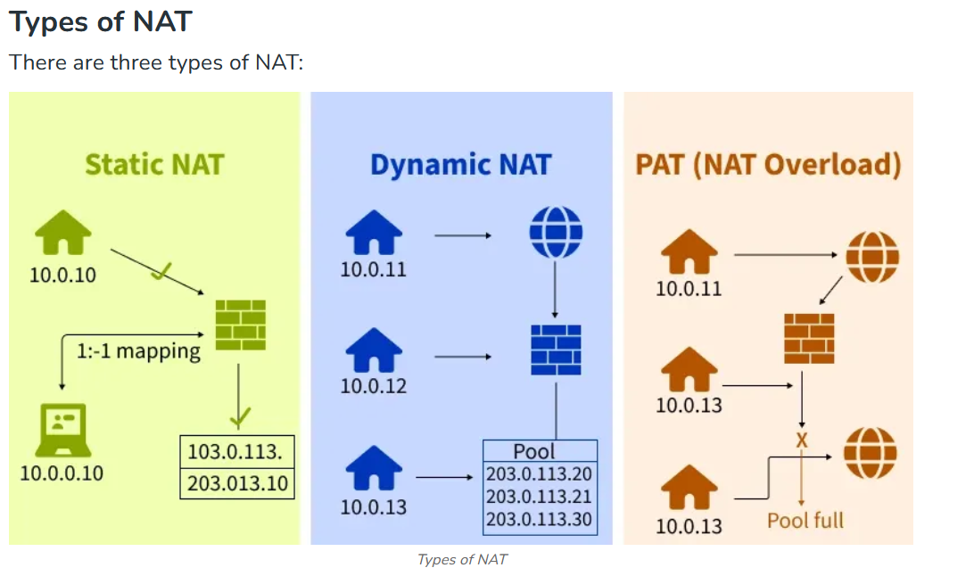

Slide 37
1. Static NAT
Maps one private IP to one public IP (one - to - one mapping).
Commonly used in hosting, but not cost - effective for large organizations since each device requires a public IP.

Slide 38
2. Dynamic NAT
Maps private IPs to public IPs from a predefined pool.
If the pool is exhausted, additional requests are dropped.
Suitable for networks with a limited number of users but still costly.

Slide 39
3. Port Address Translation (PAT)
Also called NAT Overload.
Multiple private IPs share a single public IP, with unique port numbers distinguishing traffic.
Most widely used because it’s cost - effective and supports thousands of users with a single public IP.

Slide 40
Routing Protocol
Routing Information Protocol (RIP)
The Routing Information Protocol (RIP) is designed to help routers determine the best path for sending data packets across a network.
It uses hop count as its routing metric and is primarily used in small to medium-sized networks due to its scalability limitations.
RIP operates at the Network Layer (Layer 3) of the OSI model and maintains routing tables on each router.
Every 30 seconds, routers exchange their complete routing tables with neighbours using periodic updates.
The hop count metric defines the number of routers a packet must pass through to reach its destination.

Slide 41
IP supports a maximum hop count of 15, which limits its use in larger networks. A hop count of 16 is considered unreachable.
Features of RIP
Exchanges updates periodically (every 30 seconds).
Broadcasts (RIPv1) or multicasts (RIPv2/RIPng) routing information.
Sends entire routing tables in updates.
Works on the principle of routing by rumor (trusting neighbors' information).
Uses route poisoning and split horizon to avoid routing loops.

Slide 42
Hop Count
Hop count is a routing metric that represents the total number of routers a data packet must pass through to travel from the source device to the destination device.
Each router crossed by a packet is counted as one hop.
Used by routing protocols like RIP to determine the best path.
RIP selects the route with the lowest hop count as the optimal route.
The maximum hop count in RIP is 15; a hop count of 16 is considered unreachable.
Limiting the hop count helps prevent routing loops.
This limitation reduces RIP’s scalability, making it unsuitable for large networks.

Slide 43
How RIP Works
Routing Information Protocol (RIP) is a distance-vector routing protocol that determines the best path to a destination network based on hop count.
Each router maintains a routing table containing distances to all known networks.
Routers periodically exchange routing information with neighboring routers.
Every 30 seconds, routers broadcast or multicast their entire routing table.
If a router learns a shorter path, it updates its routing table accordingly.
If a route is not updated within 180 seconds, it is marked as invalid.
If the route remains unused for 240 seconds, it is removed (flushed) from the routing table.
These timers help maintain accurate routing information and prevent stale routes.

Slide 44
RIP Used?
Small to medium-sized networks with simple routing needs.
Legacy networks that were built before OSPF/EIGRP became standard.
Educational labs for training and learning routing basics.
Backup routing protocol in case the primary protocol fails.

Slide 45
Open Shortest Path First (OSPF) Protocol
Open Shortest Path First (OSPF) is a link-state routing protocol used to find the best path between routers within an Autonomous System (AS).
OSPF routers establish neighbor relationships to exchange routing information, and these relationships play a crucial role in the formation of OSPF adjacencies.
Understanding the transitions between OSPF protocol states is essential for optimizing network performance and troubleshooting.
OSPF uses Hello packets for neighbor discovery and to establish communication between routers.
Neighbor states are key in forming OSPF adjacencies, enabling efficient routing.
The main focus of this article is to understand OSPF state transitions and their significance in the network.
OSPF requires specific parameters like matching Area IDs, authentication, and timers for adjacencies to form.
Distinguishing between OSPF neighbors and adjacent routers is critical for proper network operation.
Proper management of OSPF states ensures stable and optimized packet routing.

Slide 46
Open Shortest Path First (OSPF) Terms
Router ID: The Router ID is the highest active IP address on the router. The process first considers the highest loopback address.
If no loopback address is configured, the highest active IP address on the router's interfaces is used as the Router ID.
Router Priority: The router priority is an 8-bit value assigned to a router running OSPF, which is used during the election of the Designated Router (DR) and Backup Designated Router (BDR) in a broadcast network.
Designated Router (DR): The Designated Router (DR) is elected to minimize the number of OSPF adjacencies in a network.
It is responsible for distributing Link State Advertisements (LSAs) to all other routers.
In a broadcast network, the DR handles LSR (Link State Request) messages and responds with updates.

Slide 47
Backup Designated Router (BDR): The Backup Designated Router (BDR) serves as a backup to the DR in a broadcast network.
If the DR fails, the BDR assumes the role of DR and takes over its responsibilities.
DR and BDR Election: The election of the DR and BDR occurs in broadcast or multi-access networks.
The following criteria are used for the election:
The router with the highest priority is elected as the DR.
If there is a tie in the router priority, the router with the highest Router ID is chosen.
The Router ID is first determined by the highest loopback address, and if no loopback is configured, the highest active IP address on the router’s interfaces is considered.

Slide 48
Static and Dynamic Routing
Routing controls how data packets move from source to destination, ensuring efficient and reliable delivery. It can be done in the following two ways:
Static Routing
Dynamic Routing

Slide 49
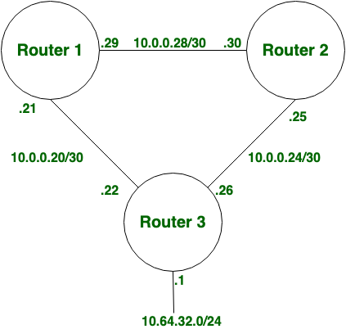
Static Routing
Static Routing is also known as non-adaptive routing which doesn't change the routing table unless the network administrator changes or modifies them manually.
Static routing does not use complex routing algorithms and It provides higher or more security than dynamic routing.

Slide 50
Advantages of Static Routing
No CPU overhead on routers cheaper routers can be used.
More secure only the administrator controls allowed routes.
No bandwidth is consumed between routers.
Disadvantage of Static Routing
Manually adding routes in large networks is time-consuming.
It requires detailed knowledge of the network topology.
New administrators must learn all routes to configure them correctly.

Slide 51
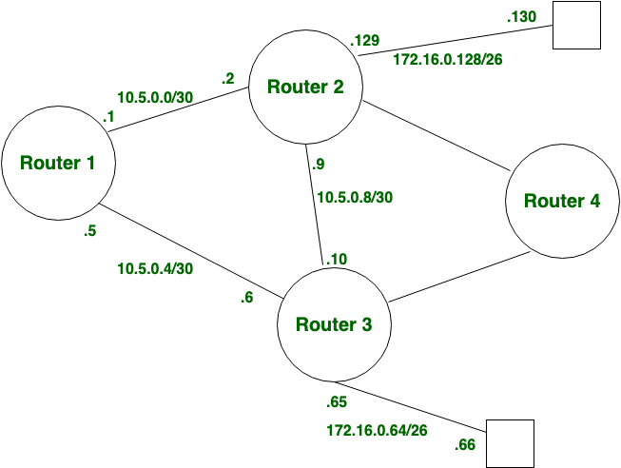
2. Dynamic Routing
Dynamic routing, also known as adaptive routing, automatically updates the routing table whenever there is a change in the network topology.
It uses complex algorithms to calculate routes, but it is less secure compared to static routing.
When a change occurs, routers exchange messages and recalculate the routes to ensure updated routing information is shared across the network.

Slide 52
Advantages of Dynamic Routing
Easy to configure.
More effective at selecting the best route to a destination remote network and also for discovering remote networks.
Disadvantage of Dynamic Routing
Consumes morebandwidth for communicating with other neighbors.
Less secure than static routing.

